Slide 1
TAO Testing Research

Slide 2
What is TAO?
“open source assessment solution for education and employment” [1]
Offer multiple solutions, from free open source, premade options, to custom built solutions for schools & organizations [2]
“Developers can access the source code for their own test-creating or administering purposes, opening the user to a wide range of potential customizations.” [3]
Ran by Open Assessment Technologies (OAT)

Slide 3
Downloads
OAT provides a free open source solution called “TAO Core” [1]
This software allows you to host a server in which users can access this TAO via a browser.
Instructors upon sign in will be shown the main test constructing page
Test takers upon sign in will be prompted will available tests to take
Windows, Linux, MacOS

Slide 4
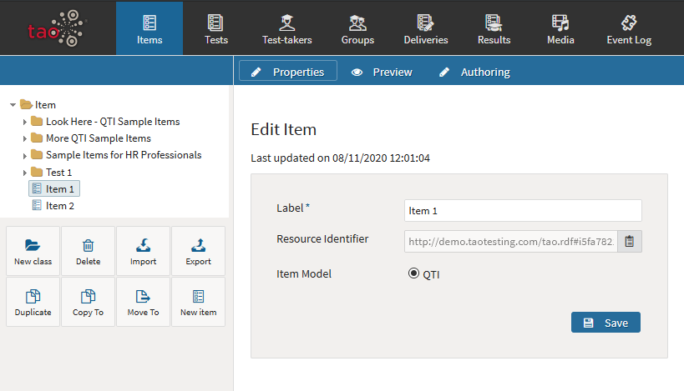
Using TAO
Sign in page
Main page for instructors
Items
Tests
Test-takers
Groups
Deliveries
Results
Extra Utilities
Sample Server
Notes:
Items: Individual Test questions
Tests: Groups of items come together to form a test
Test-taker: A user (user account),
Groups: a group of test-takers, used to easily group test-takers into classes, and then assign that class to a specific test
Deliveries: A published test, complete with assigned test time. Deliverables can’t be edited once published

Slide 5
Pros and Cons of Using TAO on our Device
Pros:
Security
Setup & Operation of servers running TAO would be the responsibility of Institutions, not us
Institutions responsible for the security of their data, nothing being held by us
Very little data is stored on headset
Less Development on our side
Test creation software already developed
Test distribution already created
Headset hardware can be simple
A lot of resources isn’t required, as the headset would only need to run a browser
Cons:
Controls
TAO Interface was designed to be used with a keyboard & mouse
Customization Required
Each Institution would have to modify headsets to use their server
Proctoring required
User could login and take test on computer instead of through the headset
Internet Connection required
You’ll have to be connected to the internet to progress through the test
Notes:
Development:
Only development on our end is test display and controls
Headset hardware:
Resources meaning processor, RAM, storage
Proctoring required:
TAO was designed to be accessed via any browser. Assuming the test taker can guess the institutions URL they’re hosting the server on, they could log in and take the test on a computer instead of the headset. Not sure if there would be any way to disable this. Potentially could look at detecting this, as it seems like TAO supports only using lockdown browsers?

Slide 6
Key Issues with TAO
Might need a keyboard to sign in to TAO&Wifi
How to prevent users from taking just on a computer?
Open source issues? Source code available
Heavy modification might be needed (if even possible), to have the test be downloaded, or we have to have constant connection

Slide 7
Overview
Tao is an option, but comes with its own challenges

